Slide 1
Hemodynamics

Slide 2
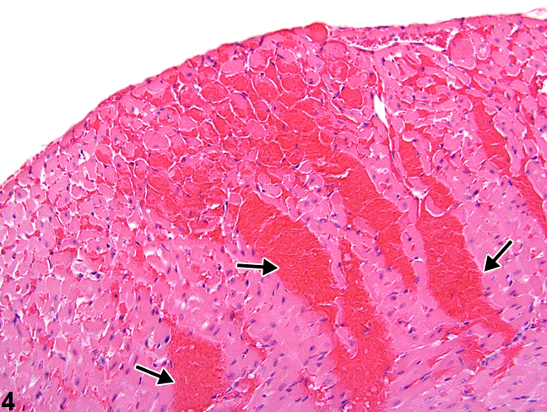
Heart : Myocardial hemorrhage may be accompanied by other morphologic manifestations of myocardial damage.

Slide 3
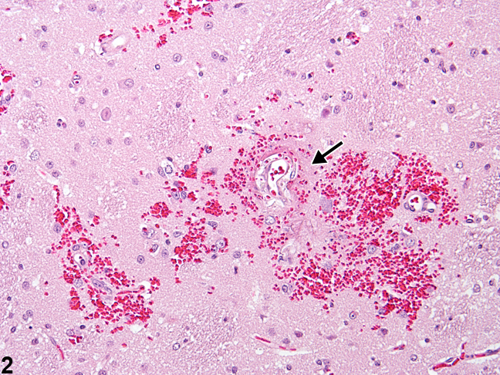
Brain : Note the accumulation of extravasated red blood cells around capillaries and the transudation of protein-rich fluid (arrow).

Slide 4
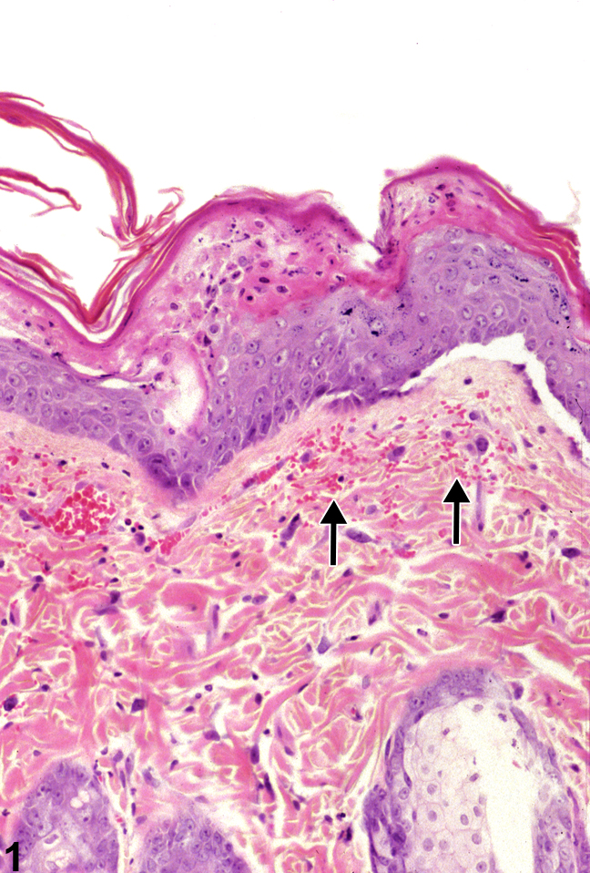
Skin : Hemorrhage in the skin is characterized by clusters of extravascular erythrocytes and thickening of epiderms.

Slide 5
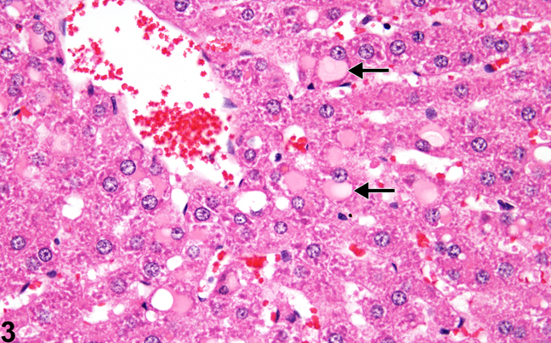
Liver : showed vacuolation of hepatocyte along with congestion of central vein and hemorrhage between hepatocytes.

Slide 6
Pulmonary edema: the alveolar walls are thickened and they are filled with eosinophilic transudate.

Slide 7
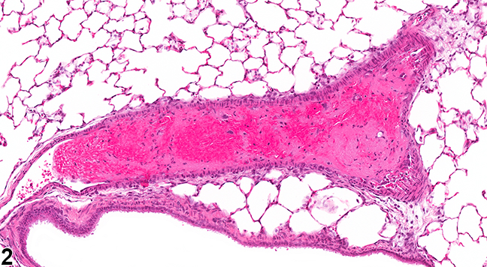
Lung : thrombus containing a large number of erythrocytes is present in a pulmonary artery.

Slide 8
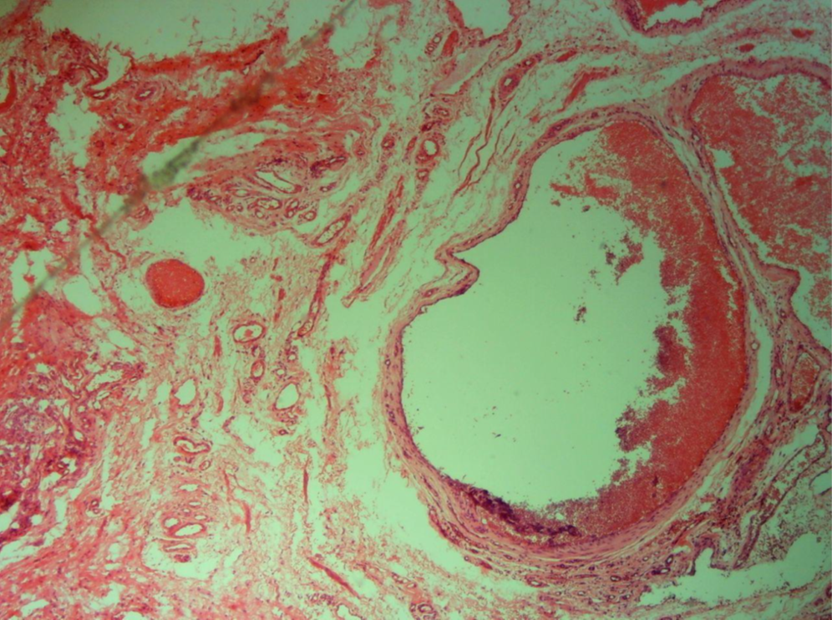
Vein with Organized thrombus: vein with organized thrombus that arranged along the periphery of the vessels.

Slide 9
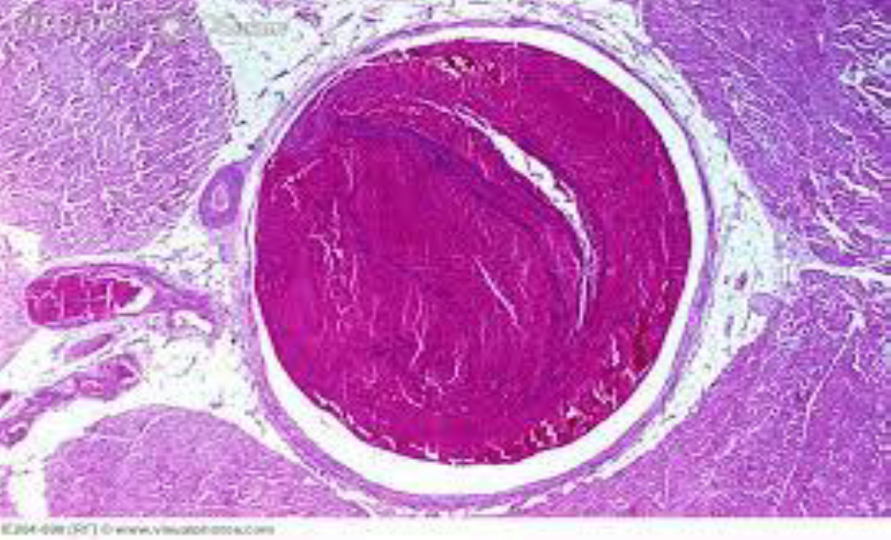
Vein with Organized thrombus: vein with organized thrombus that occlude the entire space of the vessels.

Slide 10
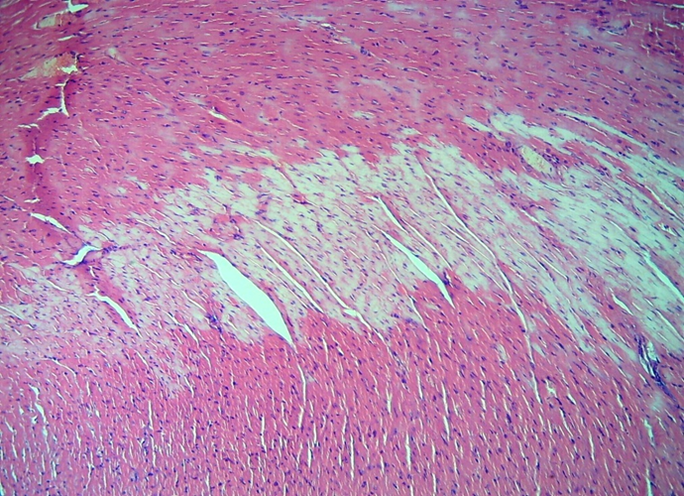
Heart : myocardial infarction, presence of pale area of cardiac muscle

